Slide 1



2023
FIRST
TERRORISM
18 U.S. Code
§ 1751
§PREA
§187

Slide 2


JANUARY 1984
2010
REGEAN - Michelbacher Strasse
- Red House
CLOCK
18 U.S. Code
§ 1751
§PREA
§187
CIVIL & CHILD ABUSE
Where is Kimberly?
Jason
Jason
Michaela
Michaela
Kimberly?

Slide 3
JANUARY 1991
FEBRUARY 1991
FEBRUARY 1991
APRIL 1991
PHYSICS
CIVIL
HUDSON
PHYSICS(otto-hahn)
PHYSICS(otto-hahn)
18 U.S. Code
§ 1751
§PREA
§187
Maria
Age 11
Maria
Age 12
Maria
Age 11
Mark
Age 11 11/12th
Mark
Stomach Ache
Stomach Ache
Dr. !Forming Fecal
Six inches cubicle
PREA
Financial Fraud
US-LUXEMBURG
HOMCIDE.LUX
(Gravitation Waves Apparatus)
PREA
Forming fecal six inches
smooth and cubicle

Slide 4
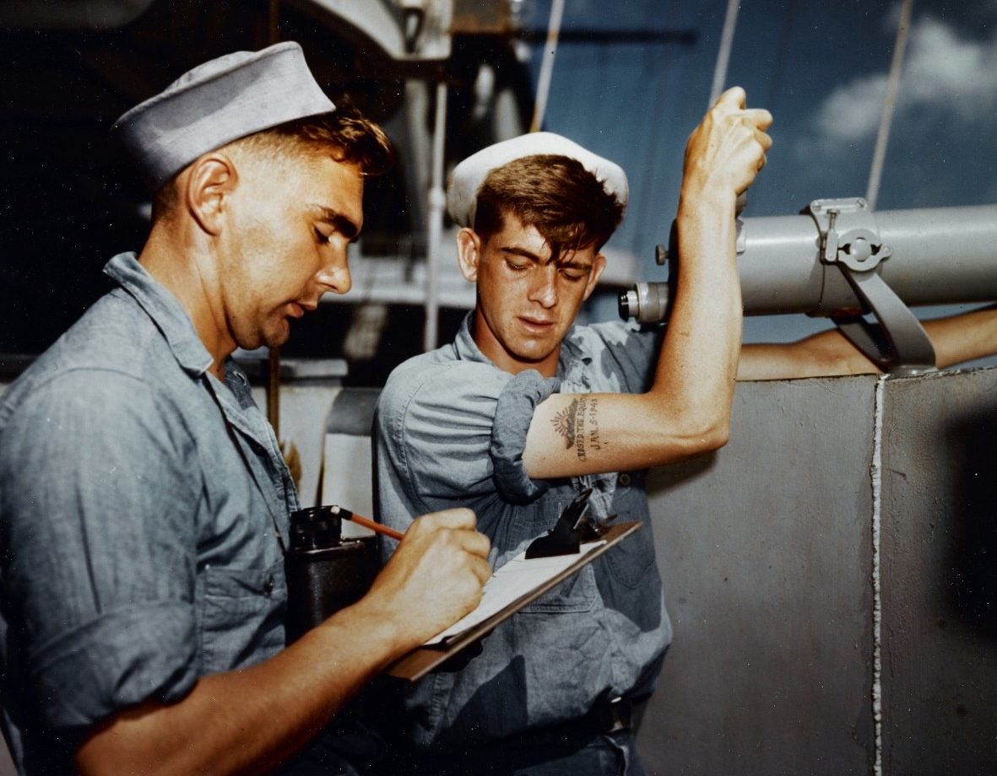

1987 MARLIN
CIVIL
18 U.S. Code
§ 1751
§PREA
§187
2023 QUARTZ
JFK.MLK.§PREA.§187
IBM.DAMILER.VISA

Slide 5
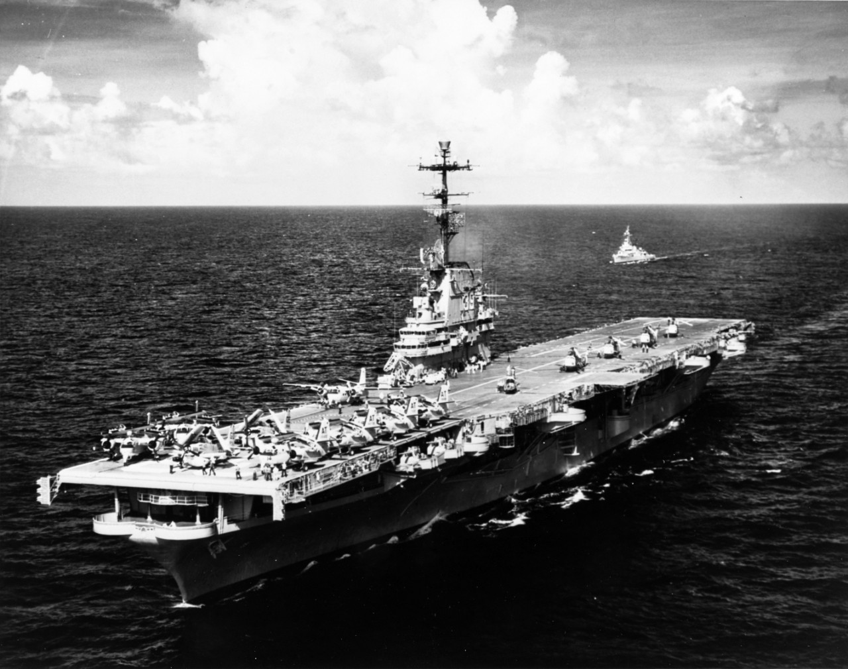
1987 MARLIN
CIVIL
18 U.S. Code
§ 1751
§PREA
§187
2023 QUARTZ
JFK.MLK.§PREA.§187
IBM.DAMILER.VISA

Slide 6
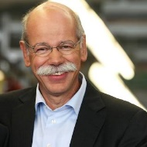
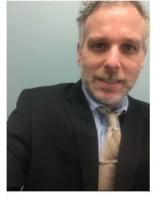
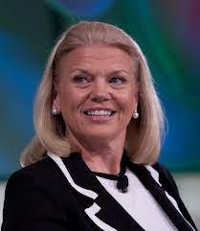
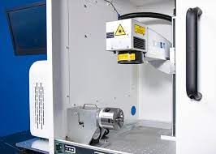

Yes, I planned sexual abuse, murder
Live, with execution! Go Beyond.
She HGB signed and added MLK.
HOMICIDE
No.
18 U.S. Code
§ 1751
§PREA
§187
Its true, Fort Worth, Lee at
IBM Client Visa, also killed John F Kennedy
See IBM Labs California Mr. Kennedy and Lee
We ignore it at your personal
expense, since 1990
BRAND: LUXEMBURG
After killing Wolgang Lux in 1994 to make
You nuthouse. And selling logical LUX, do
Like the Gravition on the Moon LUX
Machine, in 2023. Alone.

Slide 7
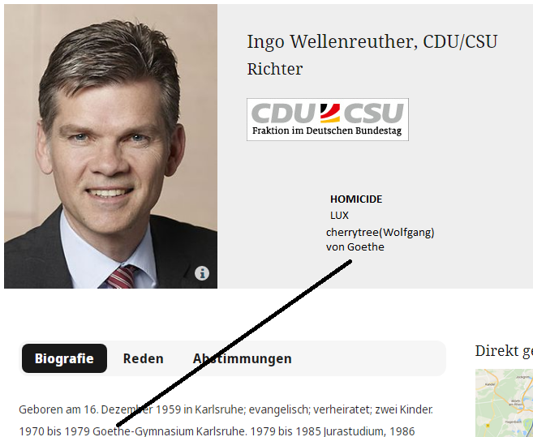
The deatlh pentaly for your family
With sexual abuse
PREA even as child, LIVE!
For scientific professional killing more
Preop and Terrirosm
HOMICIDE
No.
18 U.S. Code
§ 1751
§PREA
§187
That’s right
HOMICIDE: LUX
BRAND: LUXEMBURG
JFK.BULLET(GRAVITY MOON)
Maxplank
PREA: IBM.DAMIER.FILED.PAPER

Slide 8
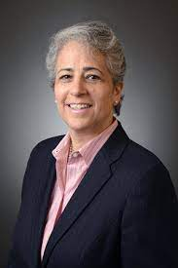
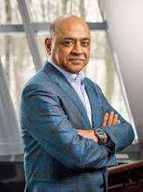
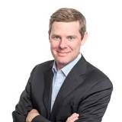
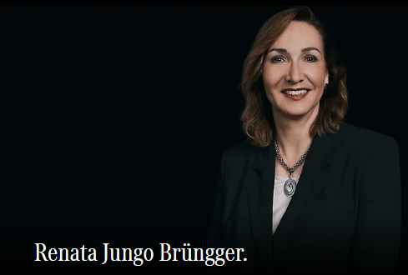
ATOM(Andrews)
18 U.S. Code
§ 1751
§PREA
§187
No.
I know about
Child abuse. I
Will wait.
Yes
Bar NY, CA
It is a further extention of the Third Reich
For TERROSIM again the United States
I have to wait.
They are all infected!
And you do the work
Delegation
LABOR_CODE Microsoft
COINTOWN anyone?
I have to wait.

Slide 9
ATOM(Andrews)
18 U.S. Code
§ 1751
§PREA
§187
No.
I know about
Child abuse. I
Will wait.
Yes
Bar NY, CA
It is a further extention of the Third Reich
For TERROSIM again the United States
I have to wait.
They are all infected!
And you do the work
Delegation
LABOR_CODE Microsoft
COINTOWN anyone?
I have to wait.

Slide 10
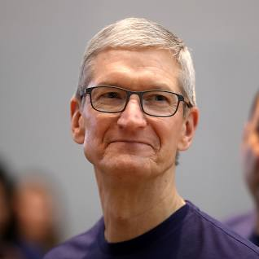

ATOM(Andrews)
CLOCK(Quartz)
TERRORSIM
18 U.S. Code
§ 1751
§PREA
§187
No.
Great Job Renata
Kindesmisshandlung in Texas
Der Auswanderer
Arnold Schwarzegger Die Totesstraffe
EINSTEIN(
Ibm.jmv 1D8723
Apple.jvm: Sweper, PREA
Stuttgart Sweeper
)
And Montirng form
Renatio or Kim. And of course
Gorbachefv Soviet Goolgers
[x] no
Stattsexamen DE 00.1 Timer Trucks Anal, Apple Sweep
Ibm.dmail.apple.jvm
Great Job Renata
Renau

Slide 11


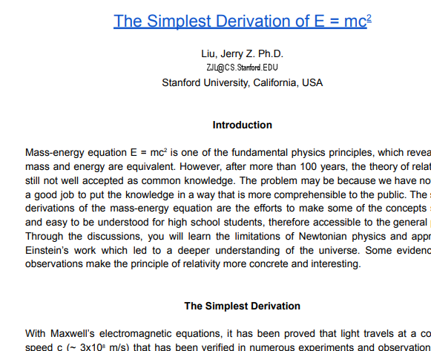
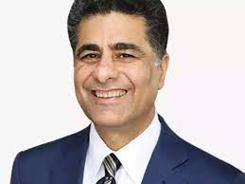
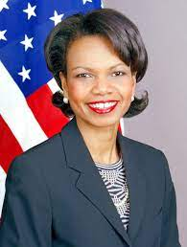

CIVIL
!HUDSON
18 U.S. Code
§ 1751
§PREA
§187
Call you Rice
Call you Rice
no
FIELD PAPERS
Gorche(dar maik, that is an idio)
And Dr. Rice. I am SAP
Call you Gorbi
ATB.EVAL 0.1 FIELD PAPERS
CLOCK(quartz)
Jerry is sick
Hello Dieter
The ignorance indicator

Slide 12
2023
TERRORISM
18 U.S. Code
§ 1751
§PREA
§187

